Slide 1


CAR RENTAL SYSTEM
Team members:
K Hruthika Manojhna
Shreya K
Amulya
Yasasri
N Shanmukh
Mentor - Suramya Biswas

Slide 2


Agenda
INTRODUCTION
TECHNOLOGY AND TOOLS
MODULES TO BE IMPLEMENTED
OUTPUT
CONCLUSION AND FUTURE ENHANCEMENTS

Slide 3
Introduction
Car Rental System
Consolidated Platform: Aggregates data from multiple car rental services.
Real-time Updates: Provides up-to-date details and rates.
Flexible Booking: Enables easy booking, cancellation, viewing, and updating of reservations.
Efficient Management: Simplifies the management of bookings, cars, schedules, and routes.
A Real-time Booking Solution:

Slide 4








#Frontend
Java Server Page(JSP)
Cascading Style Sheets(CSS)
JavaScript, HTML5
#Backend
Java 17
Spring Boot 3 (Spring MVC, Spring Data JPA, Spring Security)
Technology
And Tools
#Database
MYSQL 8
#Tools & Others
Build Tool: Maven
Web-Server: Tomcat
IDE: Eclipse IDE

Slide 5



Modules To Be Implemented
1. User Authentication and Registration
2. Customer module
3. Car Variant module
4. Car module
5. Car Booking

Slide 6


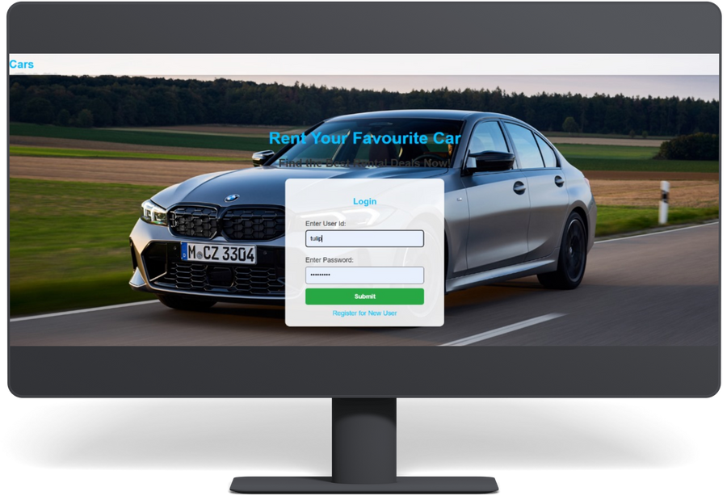
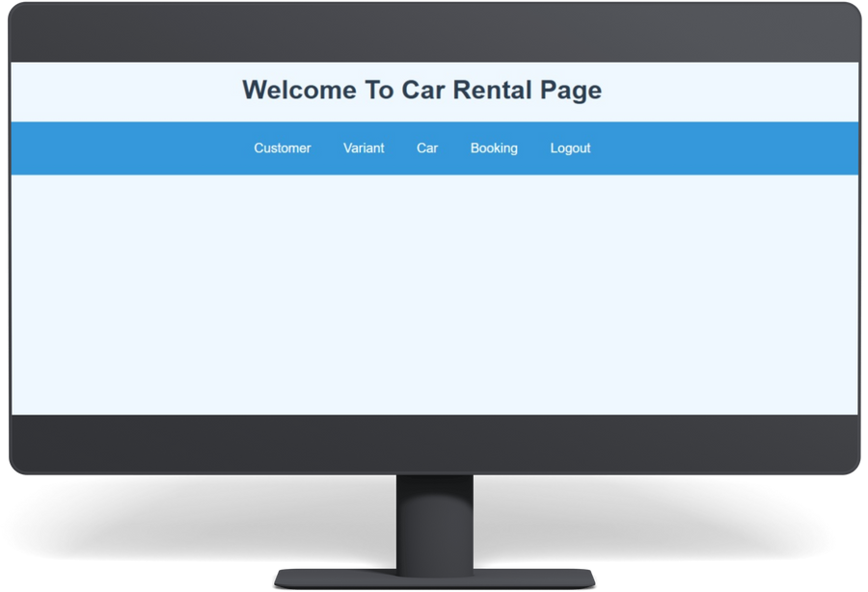
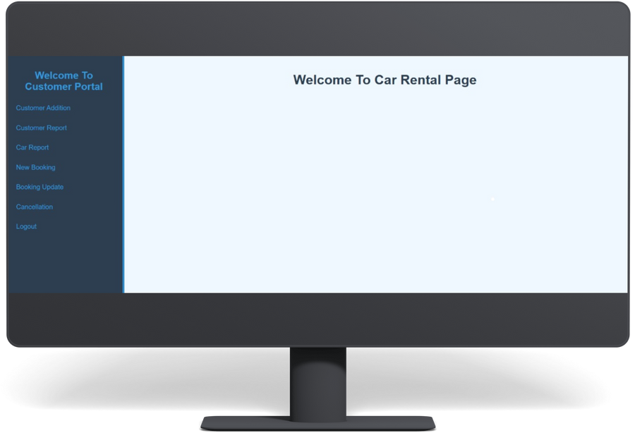
CAR RENTAL SYSTEM
OUTPUTS
Home
Service
About Us
Contact
ADMIN PAGE
CUSTOMER PAGE
LOGIN PAGE

Slide 7
CAR RENTAL SYSTEM
OUTPUTS
Home
Service
About Us
Contact
ADMIN PAGE
The administrator can:
Login into the application.
Add cars, variant and car details.
View the car, schedule and trip details.
Cancel or modify the car, schedule and payment details.

Slide 8
CAR RENTAL SYSTEM
OUTPUTS
Home
Service
About Us
Contact
CUSTOMER PAGE
The customer can:
Create his user account.
Login into the application.
Check for available cars.
Make a booking.
View the bookings made.
Cancel or modify a booking.

Slide 9
Conclusion And Future Enhancements
CONCLUSION
The Car Rental Management System offers a comprehensive solution for both users and administrators. By centralizing booking processes and providing real-time updates, it streamlines operations and enhances user experience. The system's ability to aggregate data from multiple providers empowers users to make informed decisions and find the best deals.

Slide 10

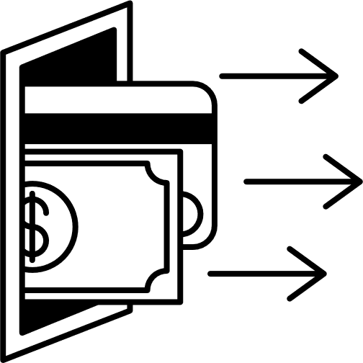
Conclusion And Future Enhancements
Mobile Application: Develop a mobile app to provide on-the-go access to booking, cancellation, and real-time updates.
Real-time Chat Support: Implement a real-time chat feature for instant customer support and query resolution.
Integration with Payment Gateways: Integrate with multiple payment gateways to offer flexible payment options.
FUTURE ENHANCEMENTS

Slide 11

THANK YOU

